Slide 1
Office Supply Co.
Analysis
2011 - 2014
By: Megan Rice , Alena Sanchez, Muhammad Aoun, and Oliver Lin

Slide 2
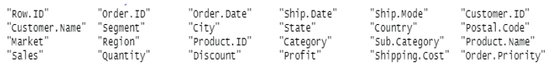

Data Overview
Office Supply Co.
51, 290 records
795 unique customers
24 variables

Slide 3
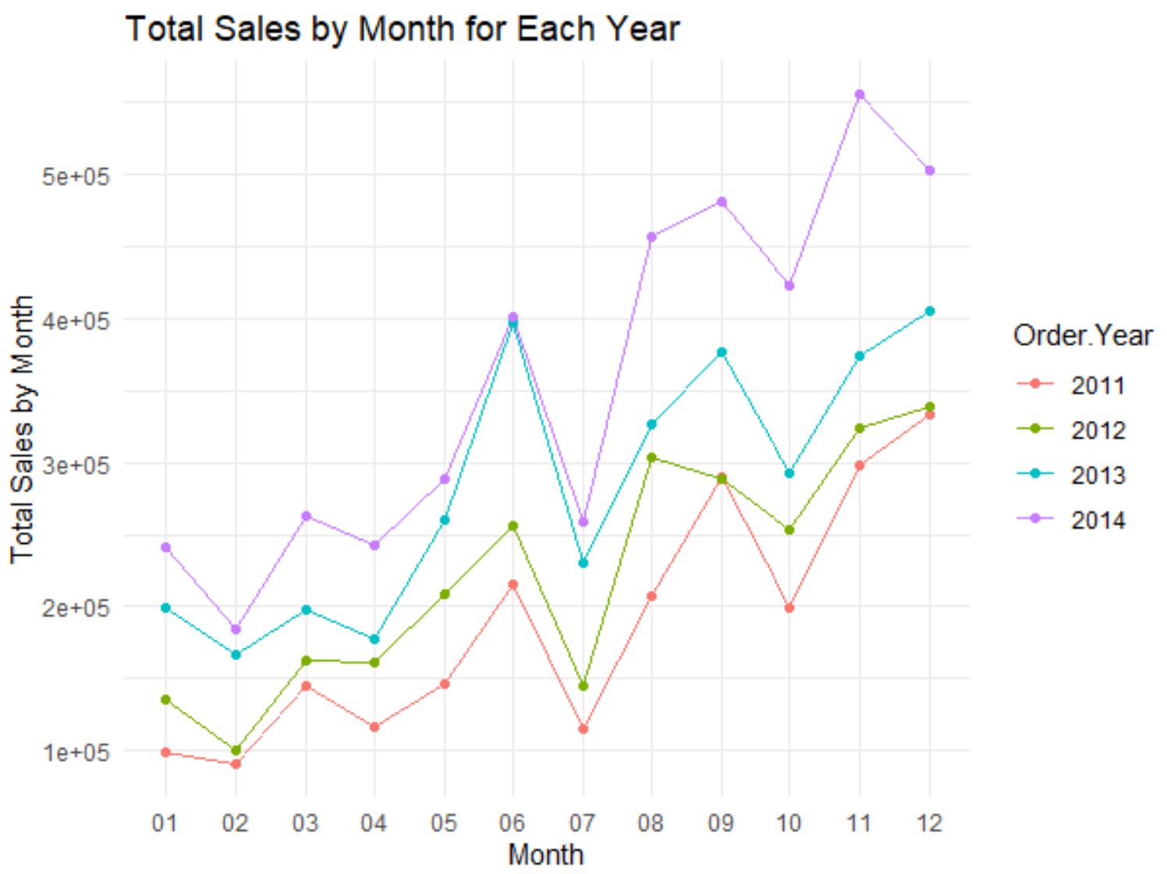
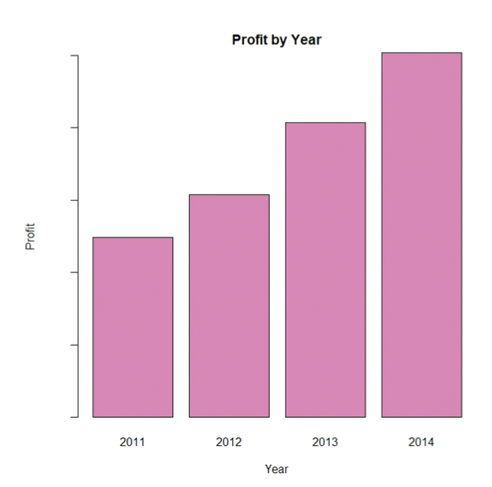
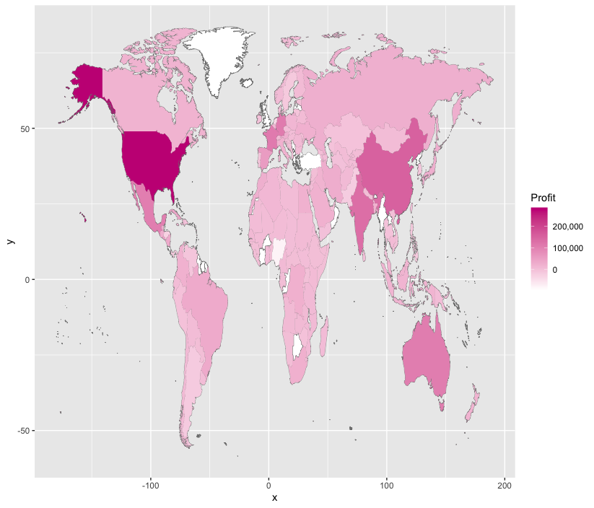
Strengths
Global Presence
Increasing Profit
Increasing Sales

Slide 4
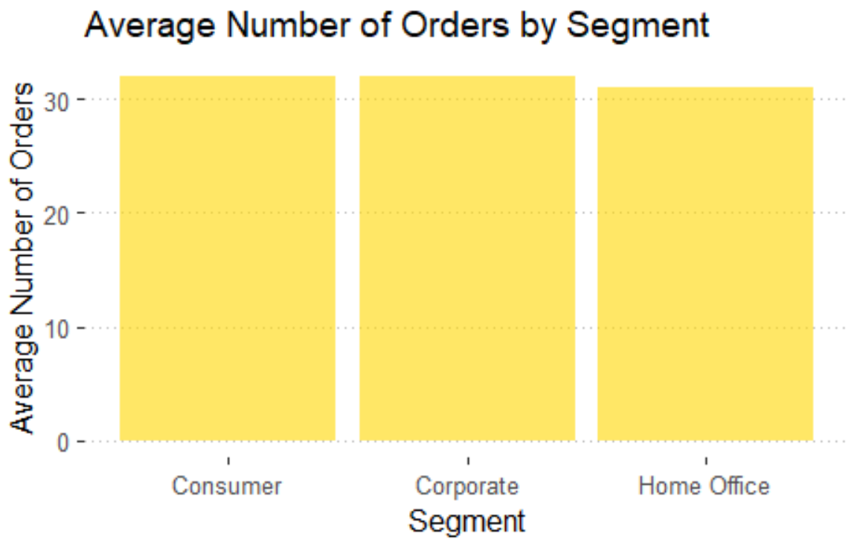
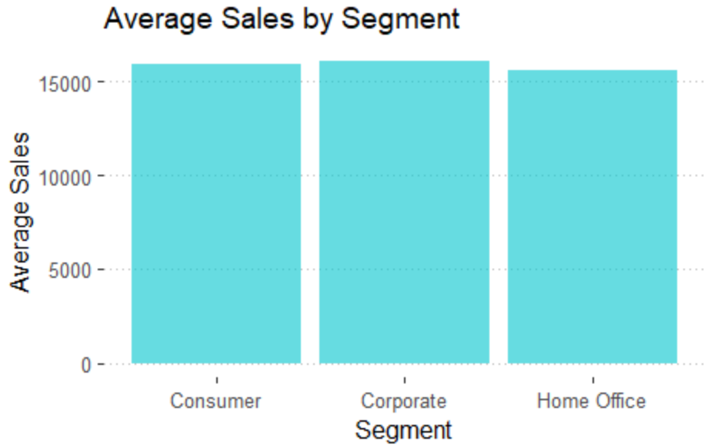
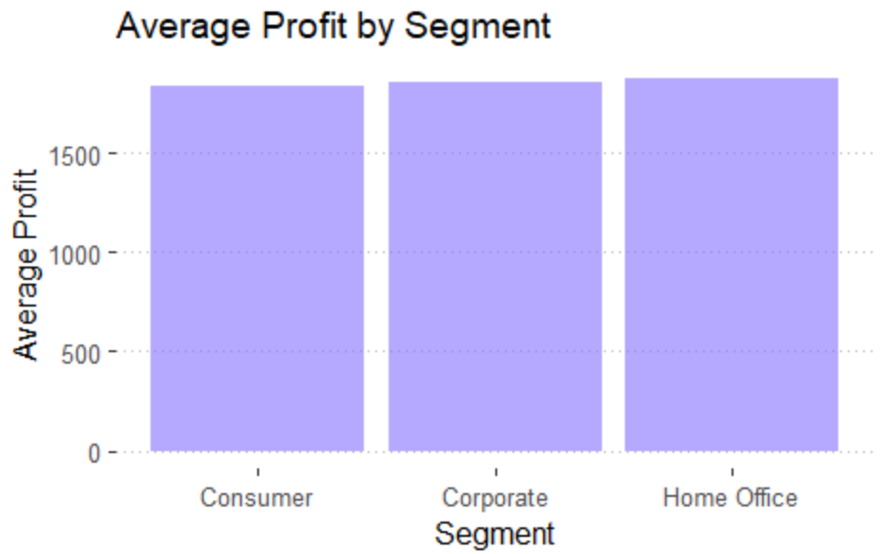

Slide 5
Define Customer Class
A
B
C
D
Total sales
Average sales
Total number of orders
Order frequency
Most Frequently
Least Frequently

Slide 6
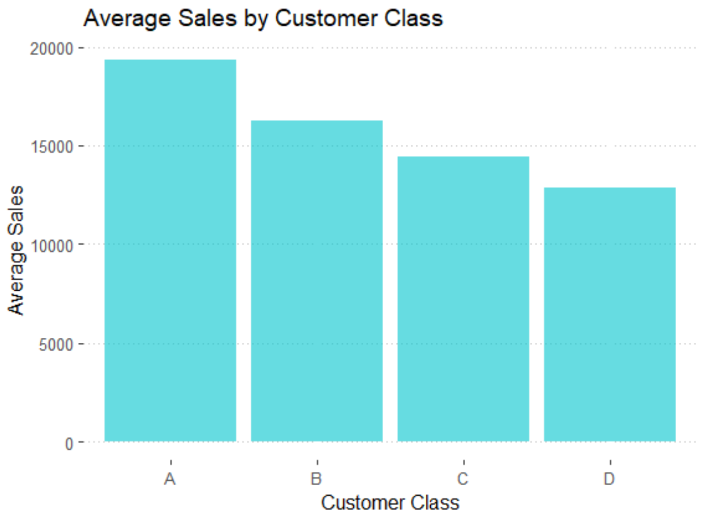
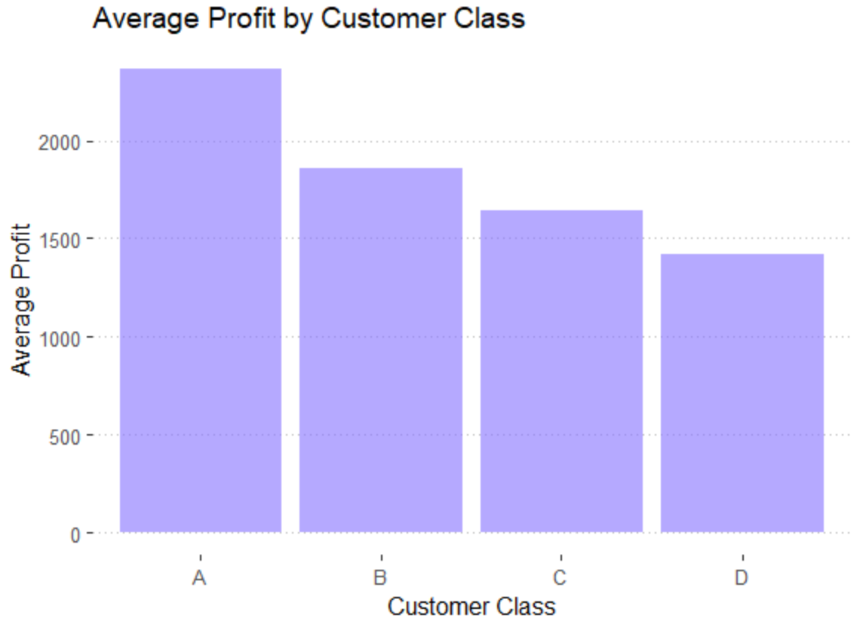

Slide 7
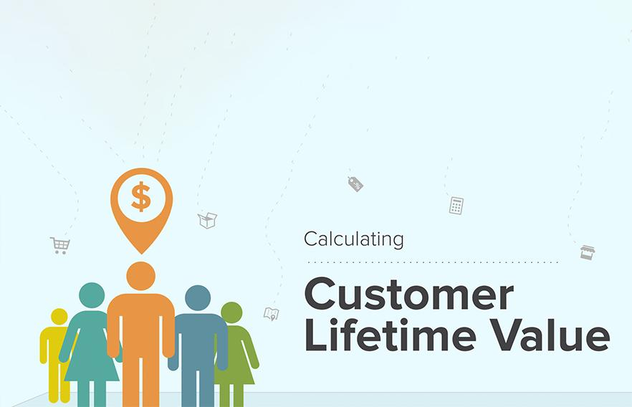
Our Approach:
01
Notes:
Past historical method
Assuming a discount rate of 10!
Approach to prioritizing a company’s spend against their high value customers. Optimize costs for a greater return.

Slide 8
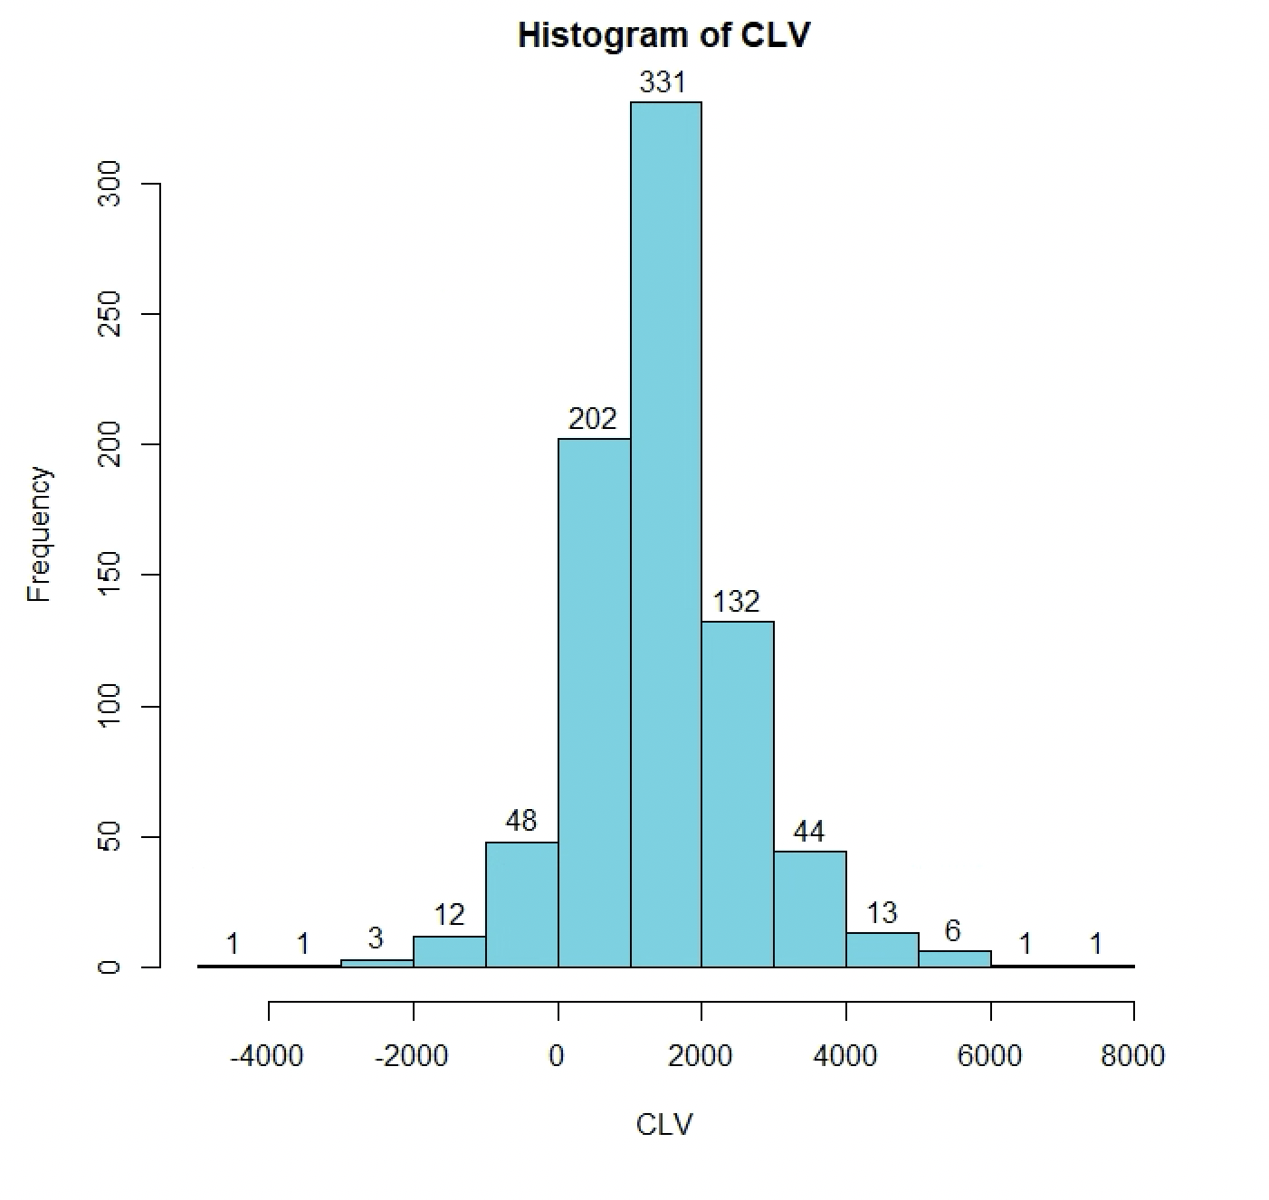
Findings:
TOP 25%: $573,658.70
Bottom 75%: $556,801.90
Notes:
Market to higher value customers -> have a greater proportionate impact as we see the top 25% has more value. Vs lower value customers

Slide 9
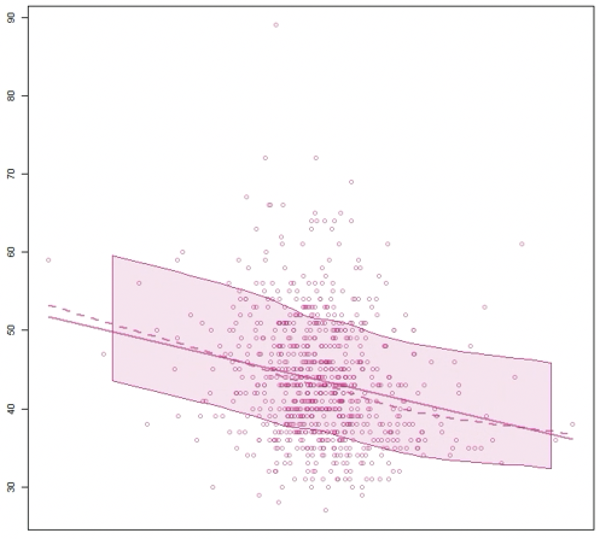
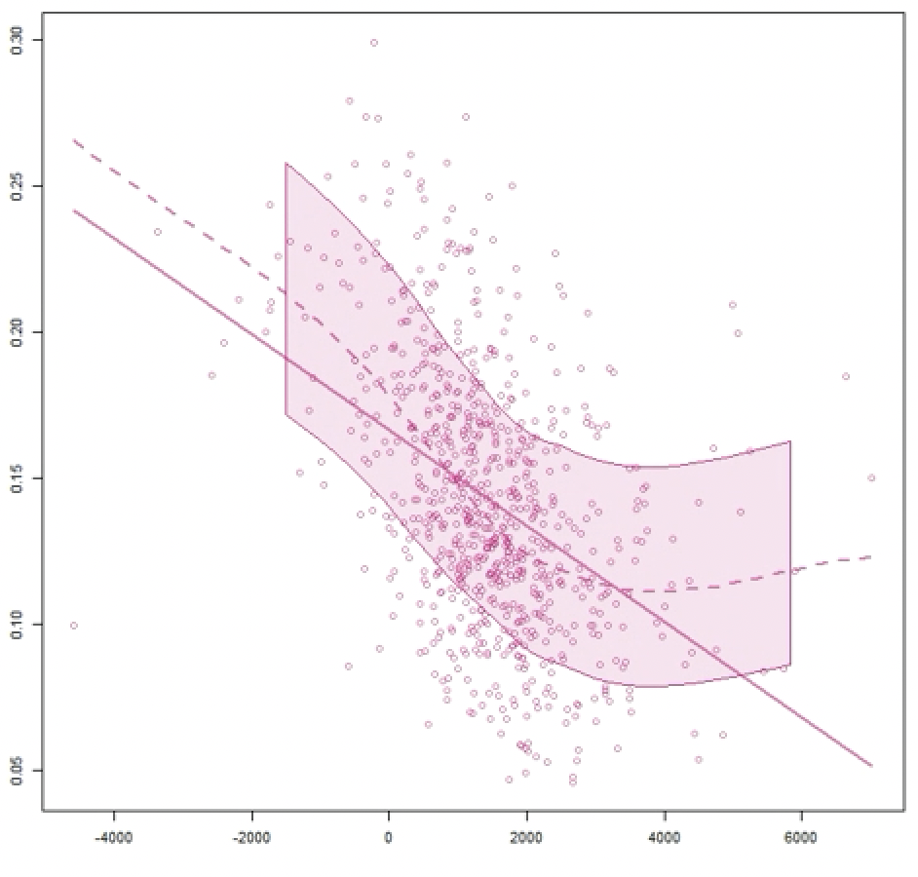
Finding Correlation:
Order Frequency and CLV
Average Discount and CLV
Notes:
**ALL significant! Order Frequency moderate correlation, the rest are strong correlations

Slide 10
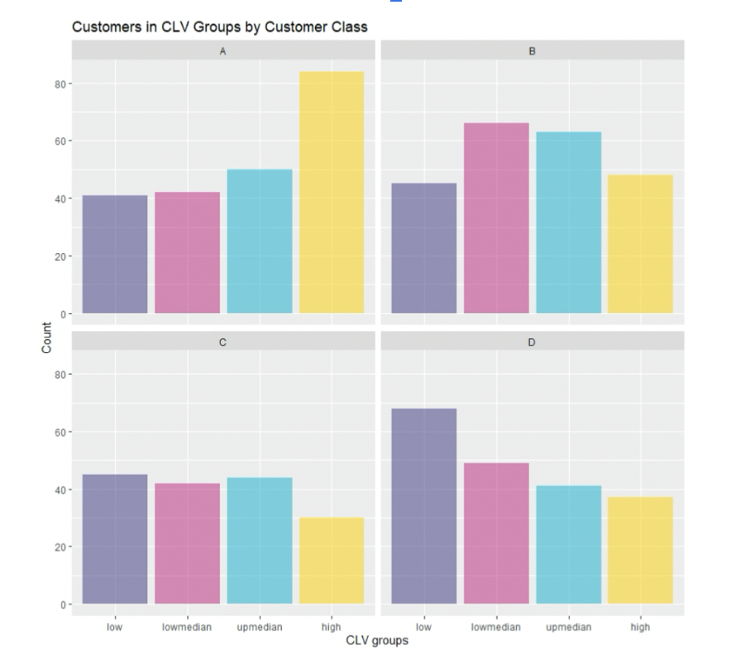
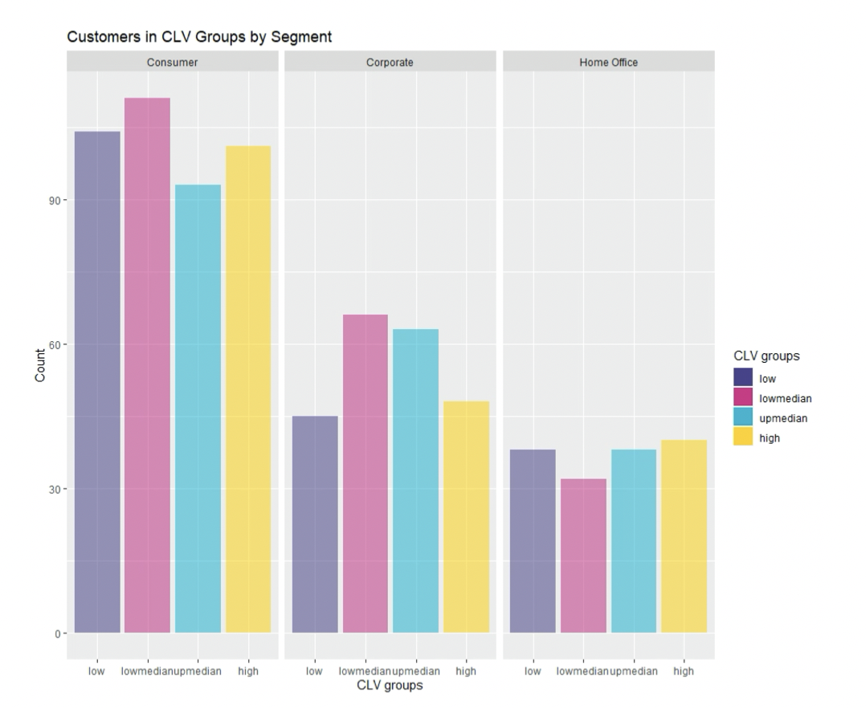

Slide 11
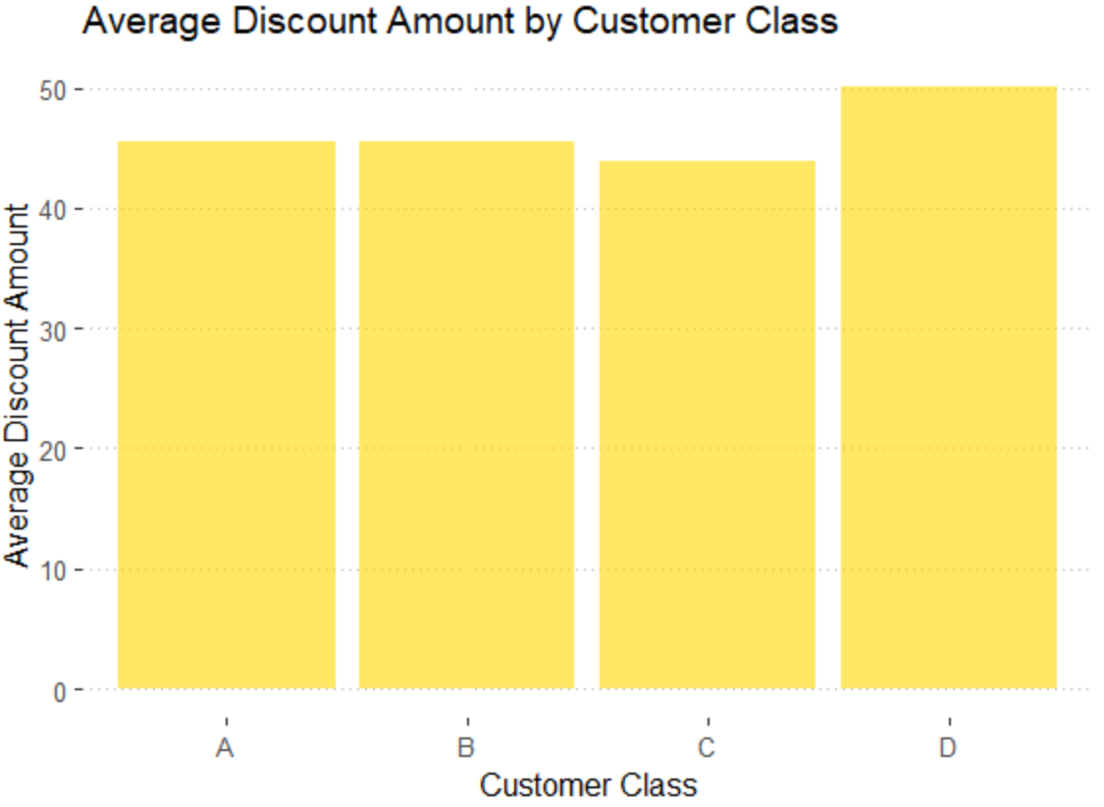

Slide 12
02 Survival
Notes:
To conduct a survival test

Slide 13
Goals
How likely they will stay
How long they will stay
What affect their survival

Slide 14
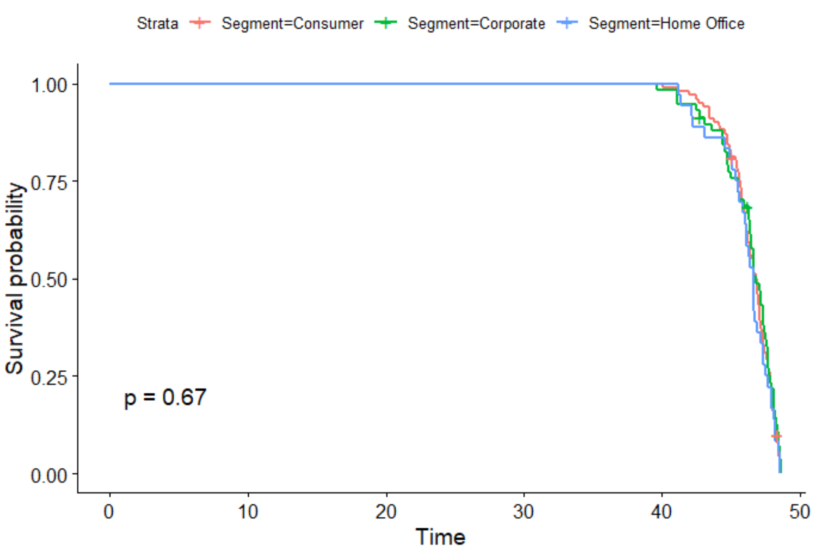
K-M: Segment

Slide 15
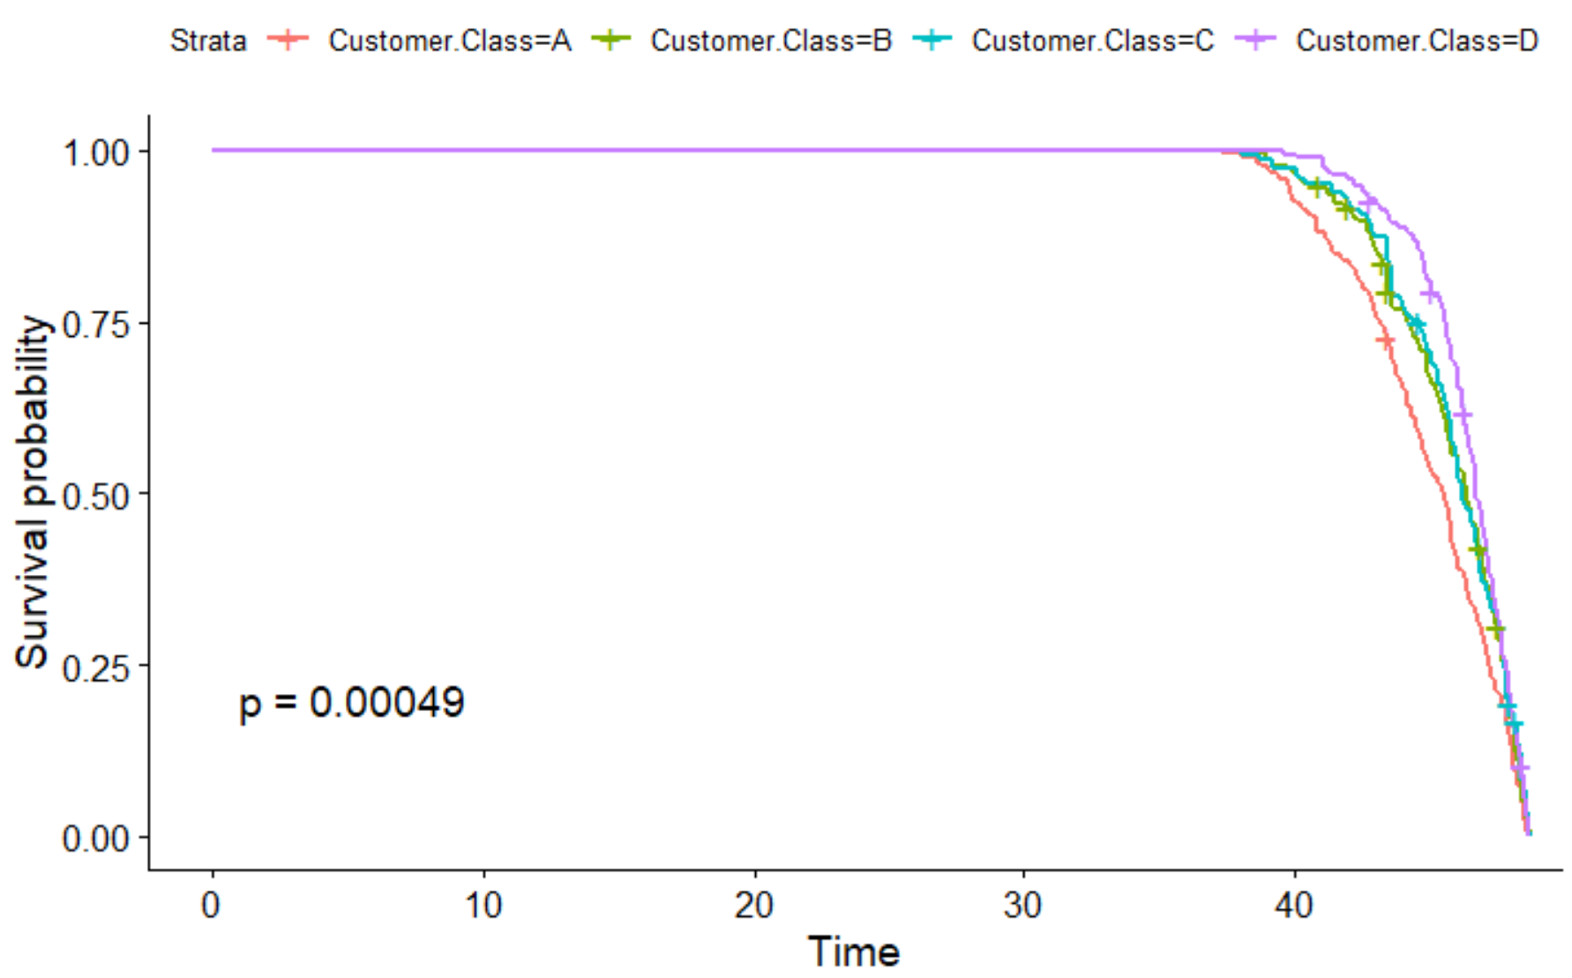
K-M: Customer class

Slide 16
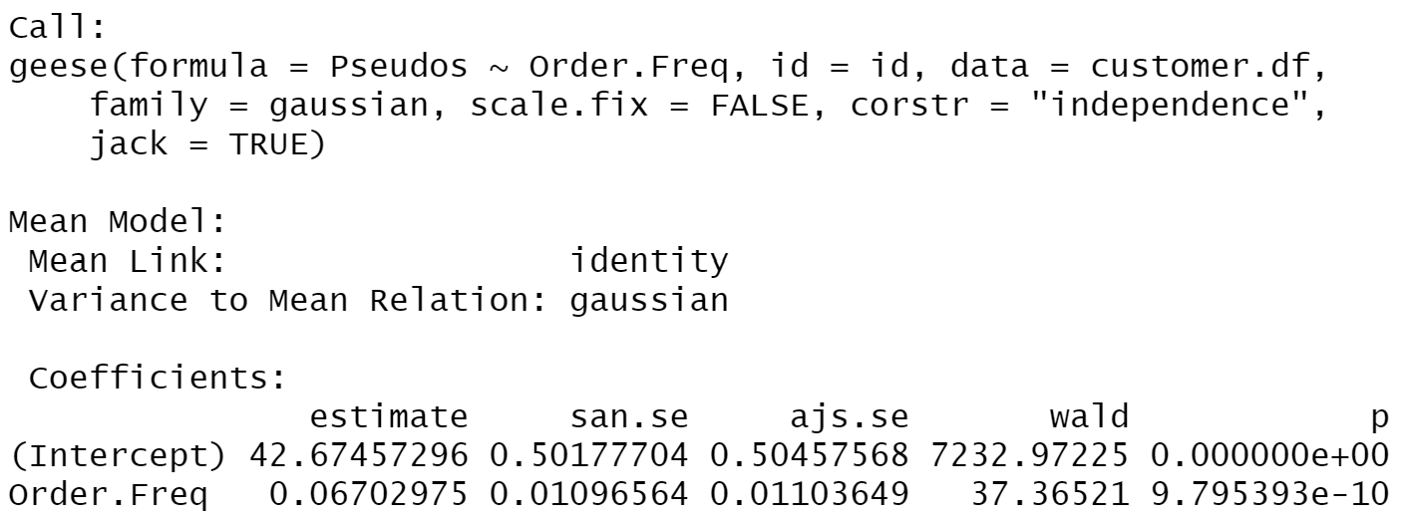
Time between Orders
Notes:
Using a pseudo test, we can see the less frequent customers are likely to have a longer survival time.

Slide 17
03 LOGISTIC REGRESSION

Slide 18

Analyzing Discount
Discount Impact: Top 25% vs Bottom 25% Customers

Slide 19
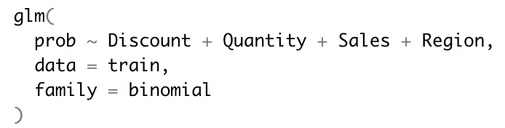

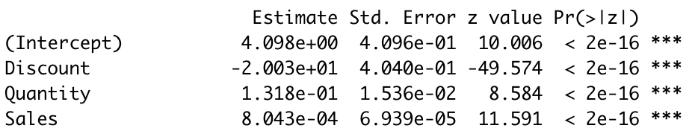
Logistics Regression MODEL
Variable
Significance
All Significant

Slide 20
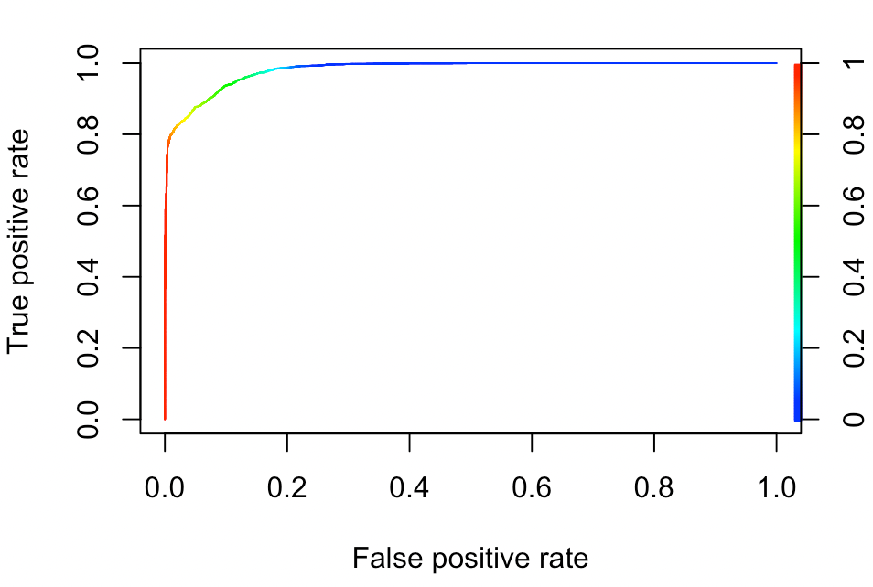
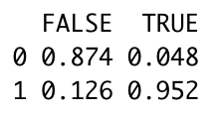
Accuracy and Impact of our Model
CONFUSION MATRIX

Slide 21
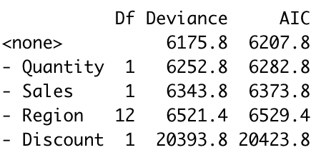


RESULTS & Interpretation

Slide 22
04 BASKET Analysis

Slide 23
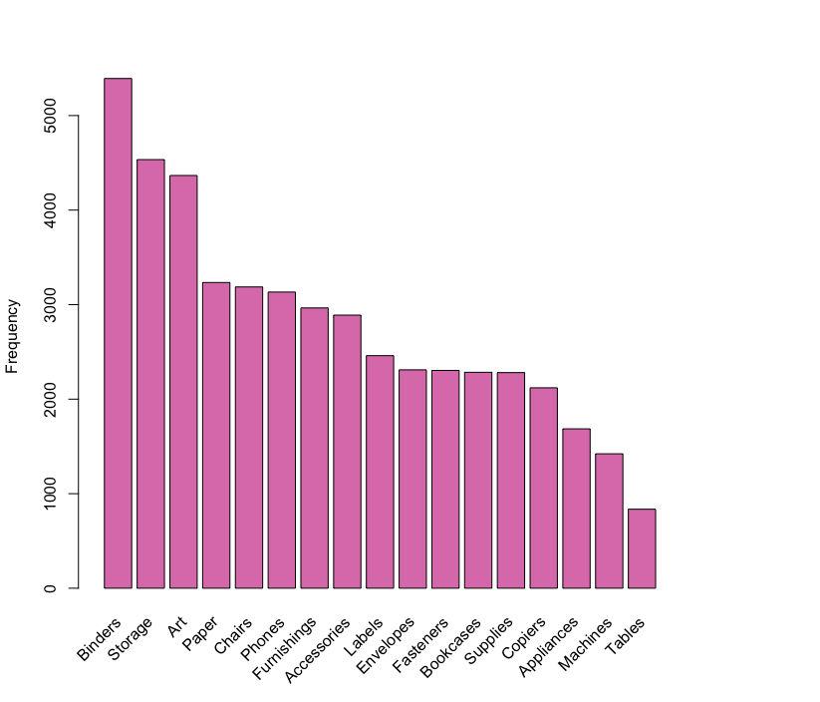
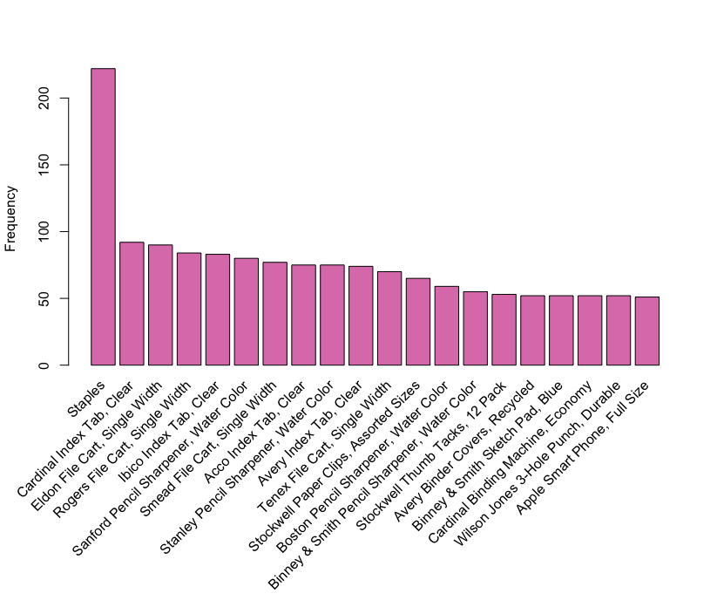
Sub-Category
Product Name

Slide 24
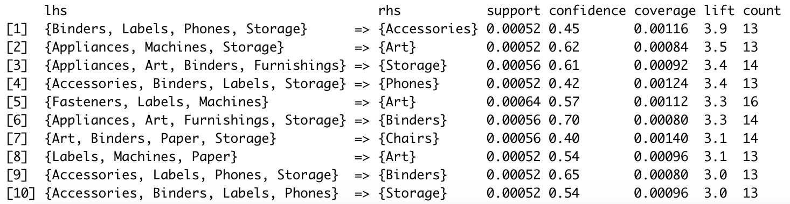

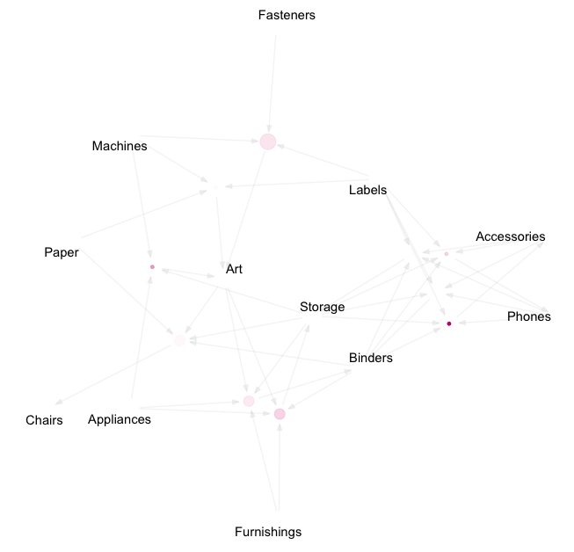
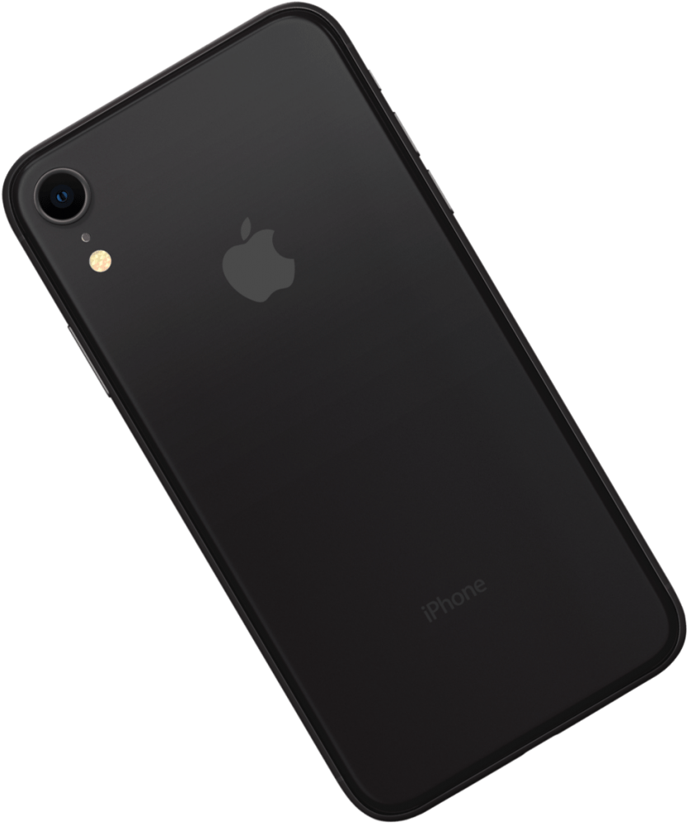
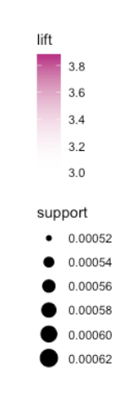
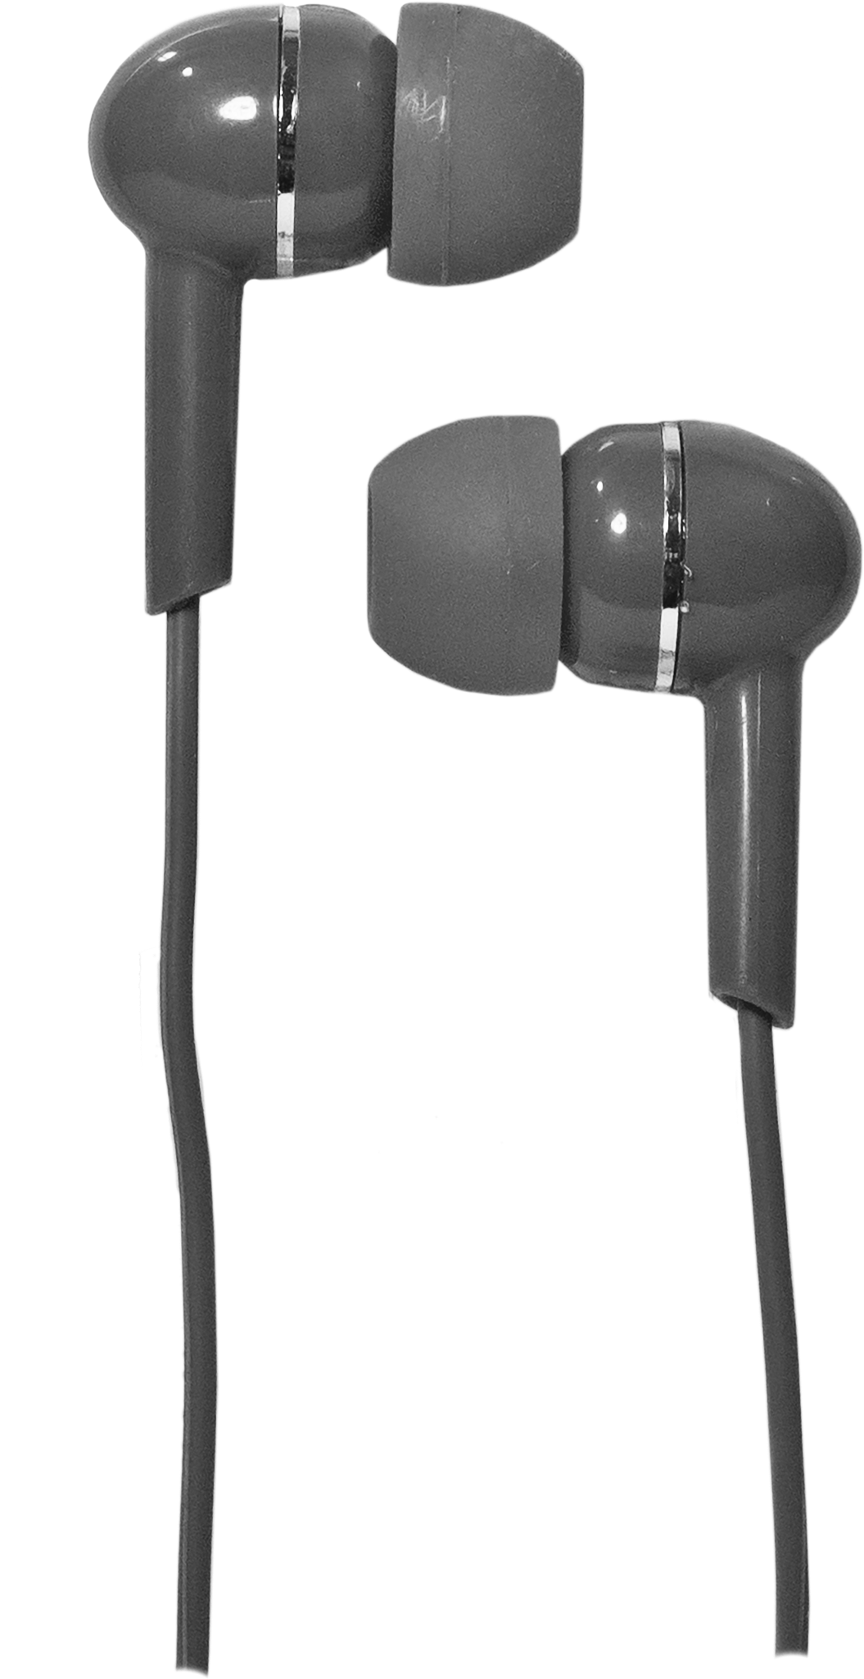




Slide 25
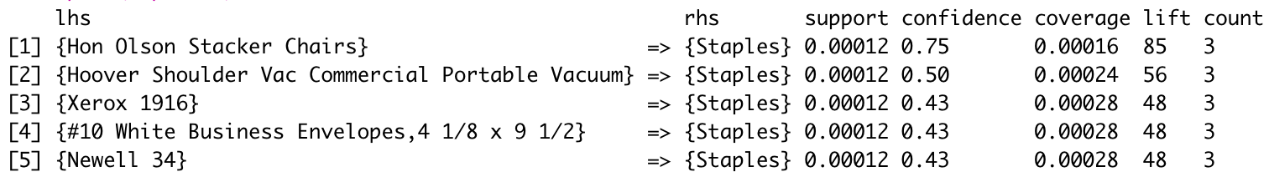
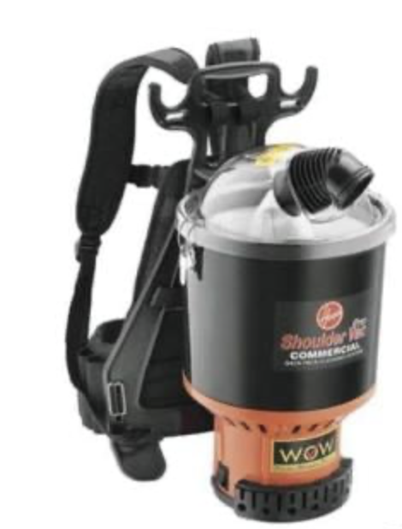
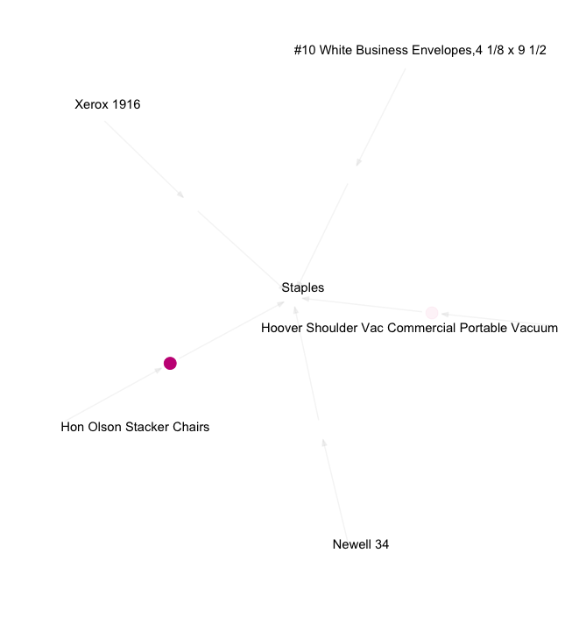
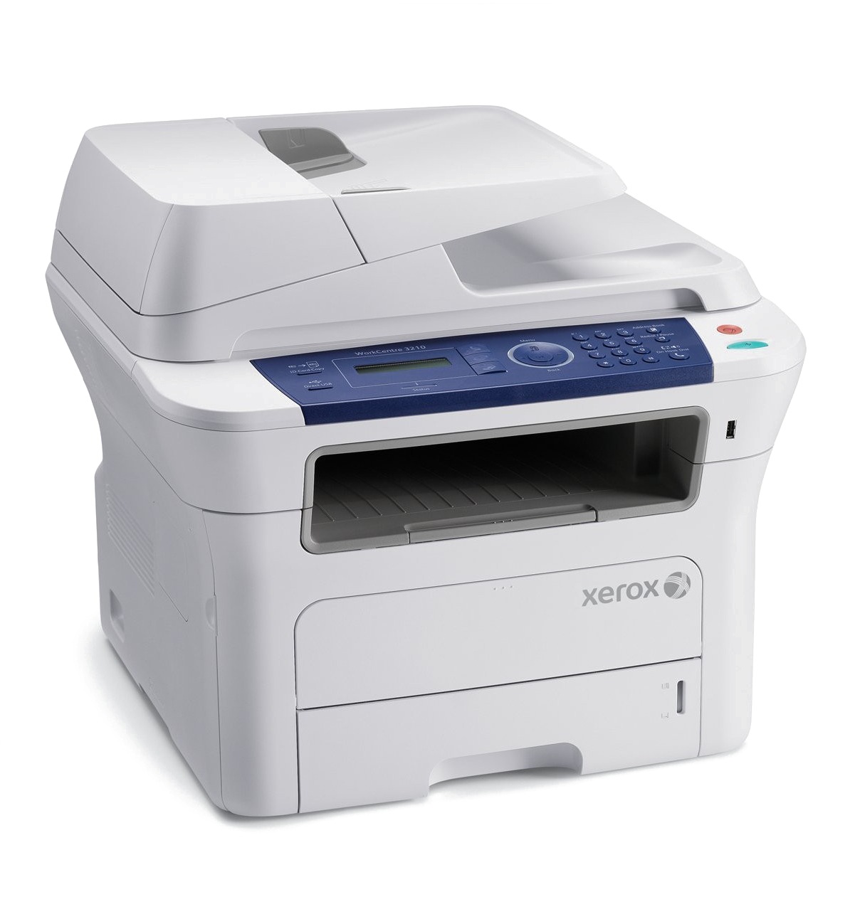
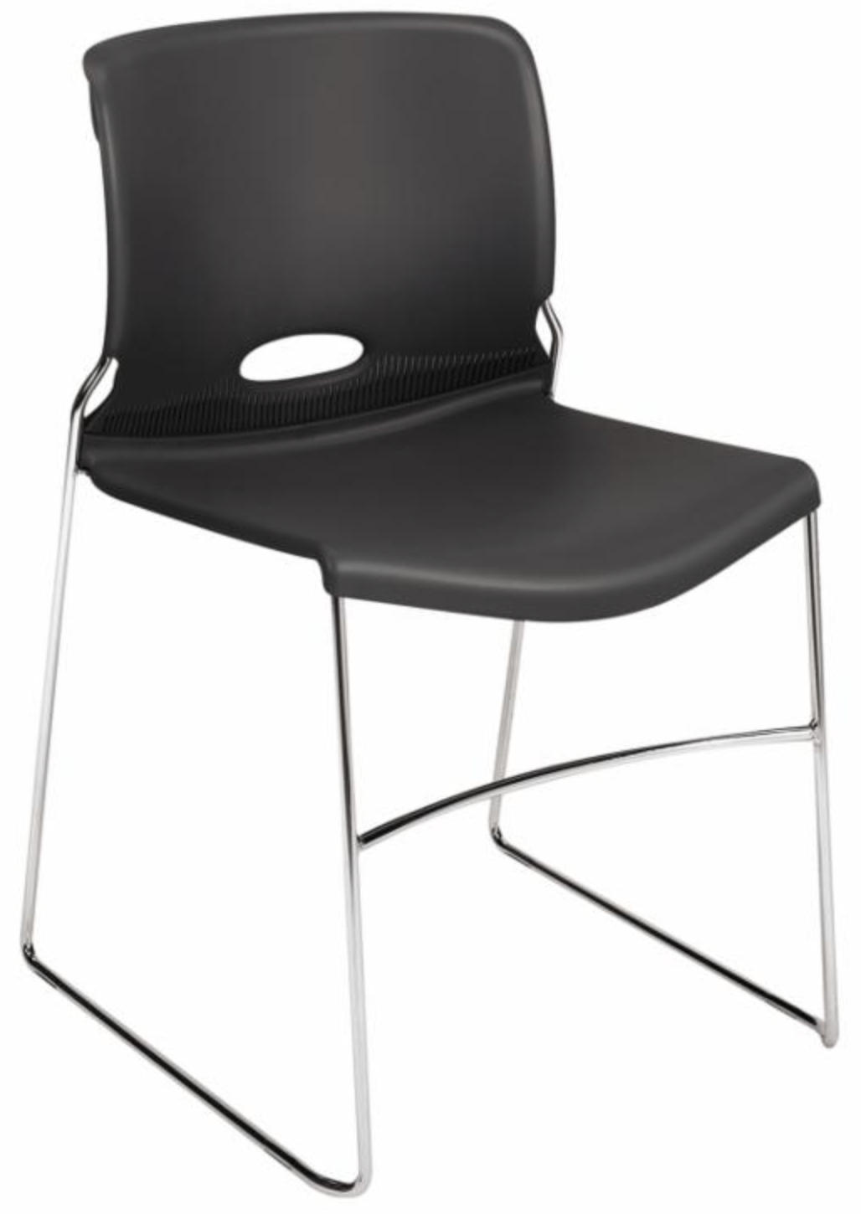
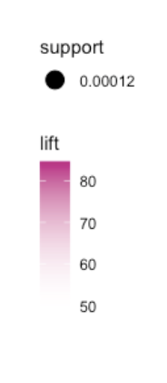



Slide 26


Product Recommendation
Marketing Promotions
recommend associated products
entice customers to purchase related products for items they purchased recently

Slide 27
Problems
Losing valuable customer
Loss in certain sub-Category
Notes:
From our analyses we found there are two main issues that our business faces.
First as Oliver found from survival analysis, the more valuable customers seem to have a overall lower survival
rate than our less valuable customers.
This means that our more valuable customers tend to leave the company.
And second, the product sales seem to be somewhat clueless. In other words, we are not focusing on our most
profitable products and categories. And our marketing system seem to be less than effective.

Slide 28
Recommendations
Emphasize Valuable Customers
Collecting Demographics Data
Product Recommendation System + Promotion
- Design more strategic discount model
-Incentivize top 25% of customers
- More demographics data will improve our models
-Helps us find more insights
-Opportunity to sell more product
-Marketing promotion

Slide 29
Learning Points
Learning Points
Statistical Significance Digging
Questions > Answers
Counterintuitive Results
Statistic Significance Digging
Questions > Answers
Counterintuitive Results

Slide 30
Questions?

